Slide 1

Ecomate
Catalyzing Sustainable Waste Solutions for a Greener Future

Slide 2

Introduction
What is Ecomate?

Slide 3
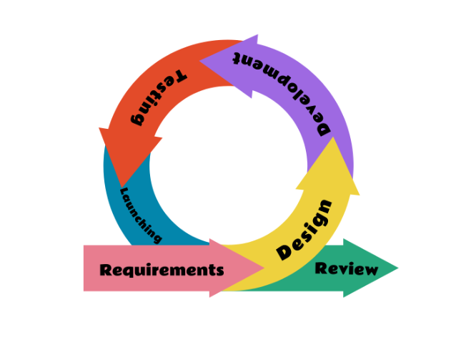
Deveplopment Model
As shown in the figure , the model is consist of six phases namely Requirements, Design, Development, Testing, Launching and Review. The illustration presents a flexible and client-centered approach to software development, enabling teams to adapt to shifting requirements, value collaboration, and provide beneficial product increments over the course of the development lifecycle.

Slide 4
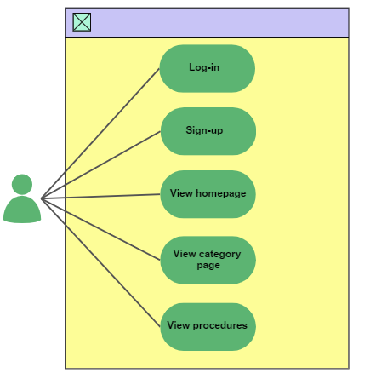
Use Case Diagram

Slide 5
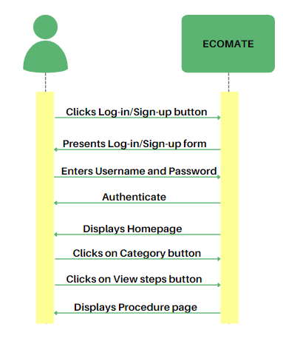
Sequence Diagram

Slide 6




Team Members
FANCUBIT, ANGEL JOY F.
SUZARA, PETE ANDREI
ANIAG, ANGELINE A.

